Slide 1


Jett Shepard, Sabrina Baccam, Melissa Kinney,
Gabri Cubero, Juanes Zapata

Slide 2
Background:
Client:
Cop the Data is a nonprofit from San Antonio, TX that aims to hold officers accountable, deter misconduct, and assist in bettering hiring conditions that are in result of a lack of police transparency laws and police department collaboration across Texas. To do this, they have made a centralized hub of visuals and data to view misconduct information that is processed by each of the police precincts.
To prevent “wandering officers” (i.e. police professionals that were either suspended or fired and then move to another police precinct that are uninformed of their previous misconducts), Bluebonnet Data has aided in dashboard and database support to house disciplinary document information and automate processes.

Slide 3
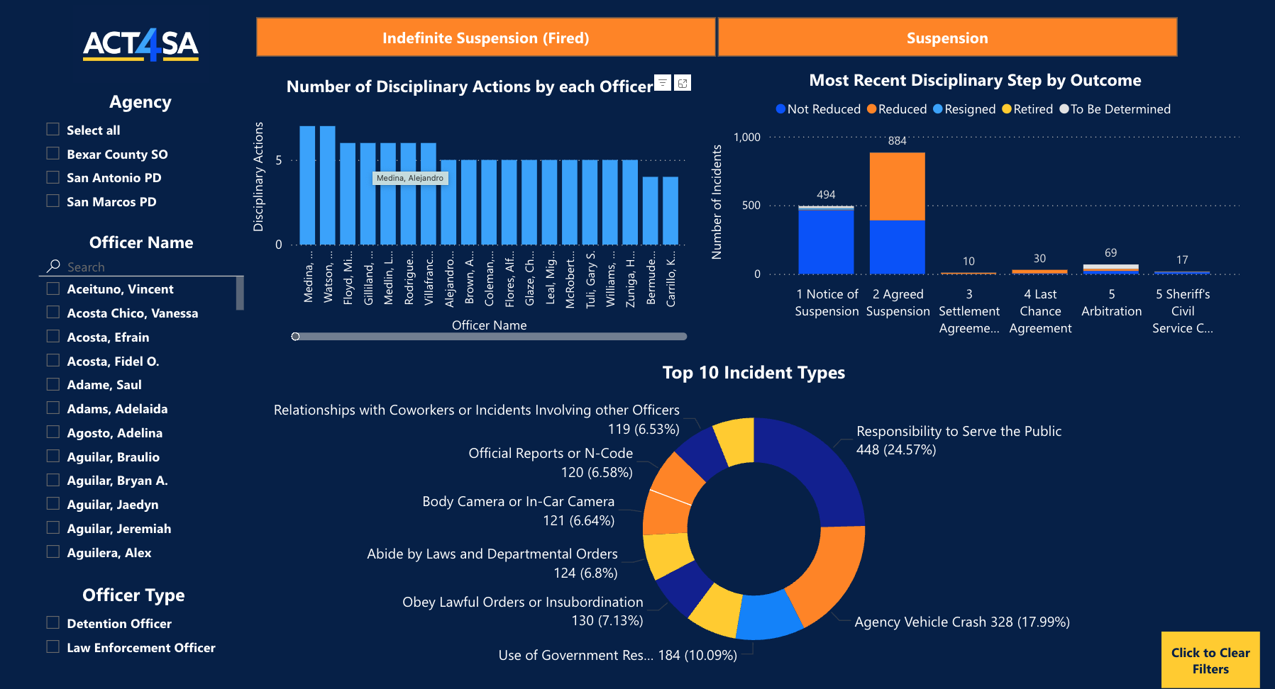
Deliverables
Previously, a PowerBI dashboard has been updated in a format that the client has approved located here. Since then, our team has worked on new document intelligence models to read police files to update connected technologies with data from them.
This interactive dashboard has been populated with data from the San Antonio Police Department (SAPD) and Bexar County Sheriff’s Office (BCSO) from the previous cohort and has been populated with data from the San Marcos Police Department (SMPD) during the current cohort. It will be updated with the Austin Police Department’s (APD) data once the Power Automate Flow is completed.
Image credited to copthedata.org via https://copthedata.com/officer-suspensions-dashboard/

Slide 4




Project Overview & Technical Specifications
Project Overview:
Bluebonnet Data helped to populate the database and dashboard by:
Creating or updating related workflows and the SQL database
Creating, training, composing, and testing new document intelligence models
Data Sources:
PDFs of different documents types including:
APD’s Notice of Suspension (NoS) documents
APD’s Agreed Suspension (AS) documents
SMPD’s Notice of Suspension (NoS) documents
SMPD’s Last Chance Agreement (LCA) documents
Tools:
Power App
Power Automate
Azure SQL Database
Power BI
Data in the form of PDFs are to be inputted through a Power App
The data will be processed through flows created and connected by Power Automate
Data will then populate in the SQL database within Azure so the dashboard can read from the records
Data is then presented via a configured Power BI dashboard

Slide 5
Completed Tasks, Next Steps, and Blockers
Completed:
Created, trained, and composed document intelligence models for each of the document types
Created and updated data points in the SQL database and the Power App to test new flows
Documentation for future cohorts including both written and video information
In Progress:
Testing all composed models for sufficient accuracy/confidence scores for each fields
Next Steps:
Continue adding more police departments’ document data
New flow for APD - NoS model will need to be created in Power Automate and connected in the Azure SQL database
Blockers:
Lost two cohort members and could not receive specific import keys from one until after the cohort (which prevented us from testing one model’s accuracy on time)
The SMPD - LCA document type model has a very limited number of documents available to train on and thus results in low confidence scores from the AI’s predictions
Our point-of-contact for our client has left their position in the middle of the cohort, so access to specific technologies were blocked and limited until they could get back from traveling

